Slide 1
SMART FARMING
Group – 32 – The Unpredictables
Pericharla Phani Sathvika
Chikkala Sri Lakshmanarao
Vadapalli Sreerama Adithya
Yeragamreddy Suneethareddy

Slide 2
Progress Made till now and Work division
Progress
Lab – 1 : Division of Work and Preparation of timeline and started Hardware Implentation
Lab – 2 : Implementation of Hardware is done and started soldering the circuit onto PCB
Lab – 3 : Finished Soldering and Started to work on Dashboard.
Work Division
Hardware : Sathvika, Adithya
Thingspeak : Lakshman
Dashboard : Lakshman
Presentation : Adithya

Slide 3
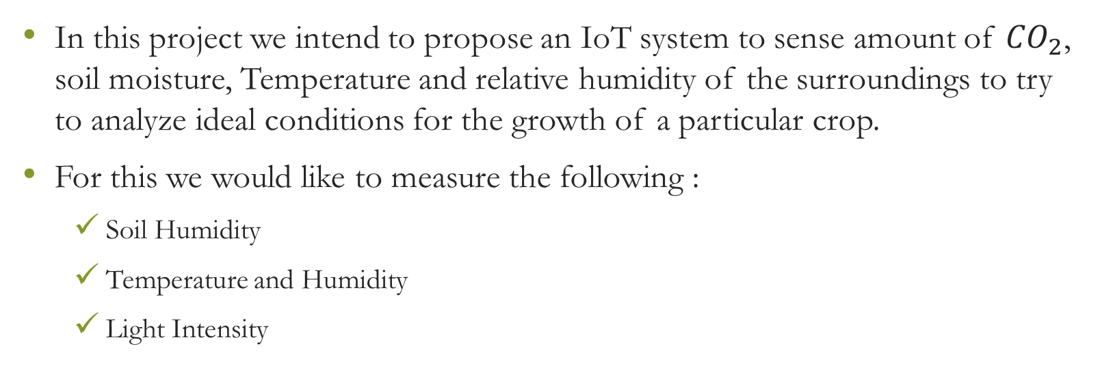
MOTIVATION OF THE PROJECT
In this project we intend to propose an IoT system to sense amount of ${CO}_{2}$, soil moisture, Temperature and relative humidity of the surroundings to try to analyze ideal conditions for the growth of a particular crop.
For this we would like to measure the following :
  Soil Humidity
  Temperature and Humidity
  Light Intensity

Slide 4
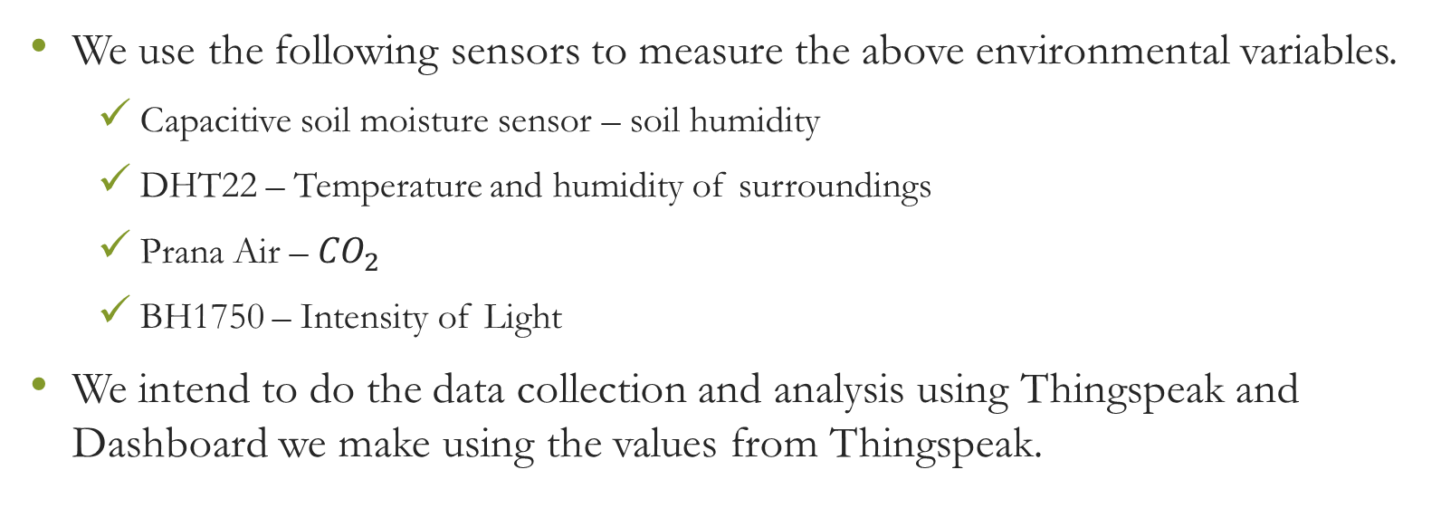
IMPLEMENTATION OF THE PROJECT
We use the following sensors to measure the above environmental variables.
  Capacitive soil moisture sensor – soil humidity
  DHT22 – Temperature and humidity of surroundings
  Prana Air – ${CO}_{2}$
  BH1750 – Intensity of Light
We intend to do the data collection and analysis using Thingspeak and Dashboard we make using the values from Thingspeak.

Slide 5
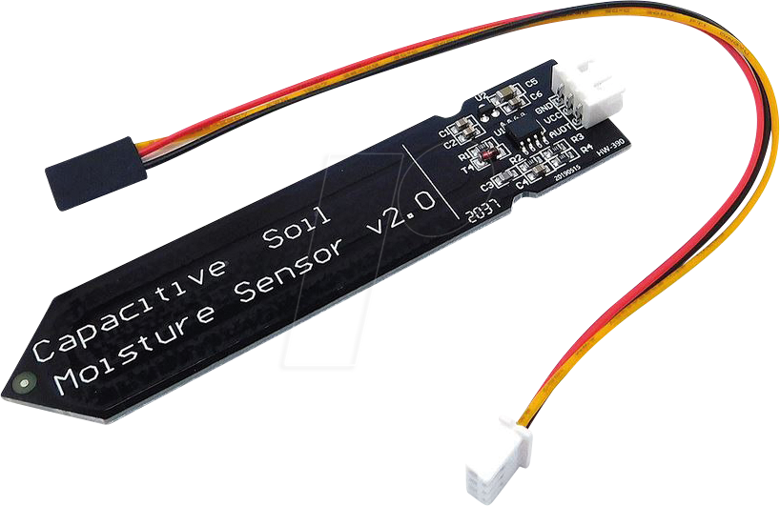
Capacitive soil moisture sensor
This sensor measures the amount of moisture present in the soil.
To do this the sensor uses capacitive sensing

Slide 6
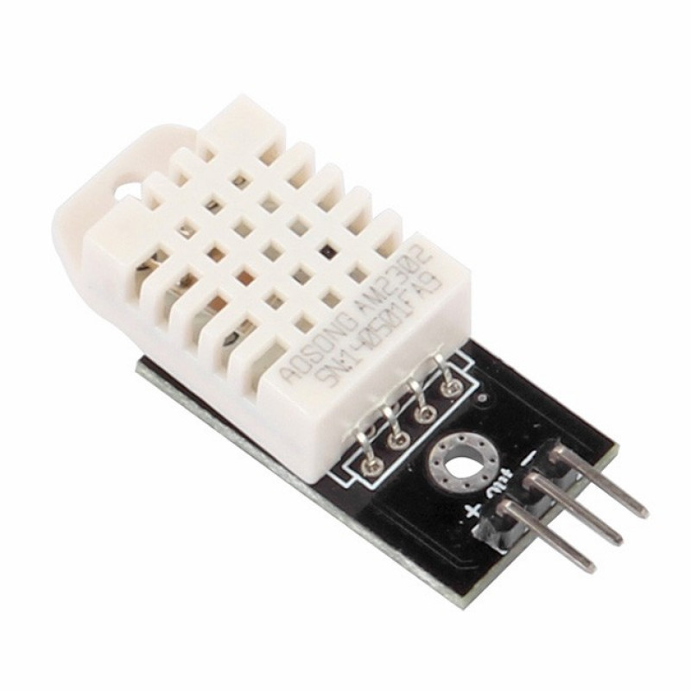
DHT22 Sensor
Measures Temperature and humidity of the surroundings.
This sensor uses a thermistor to measure temperature and a capacitive humidity sensor to measure humidity.

Slide 7
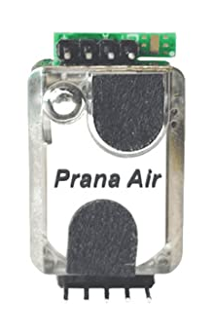

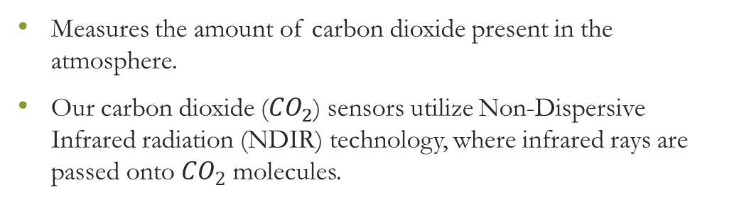
Prana Air ${CO}_{2}$ Sensor
Measures the amount of carbon dioxide present in the atmosphere.
Our carbon dioxide (${CO}_{2}$) sensors utilize Non-Dispersive Infrared radiation (NDIR) technology, where infrared rays are passed onto ${CO}_{2}$ molecules.

Slide 8
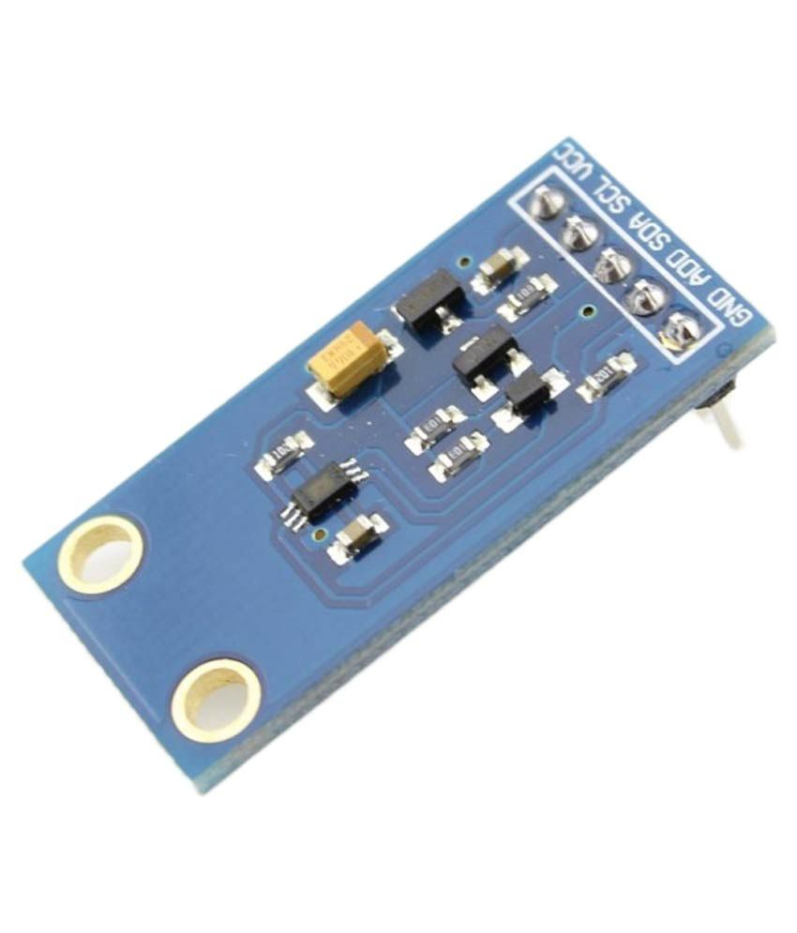
BH1750 Ambient Light Sensor
Measures light intensity.
Works with I2C Serial Communication.
It converts the light energy into electrical signal.

Slide 9
Software Implementation
Values are uploaded onto Thingspeak.
Those uploaded values are again retrieved from Thingspeak to implement Dashboard.

